Slide 1

TEAM : 1
BREAST CANCER DETECTION USING ADABOOST CLASSIFIER
~ Enhancing Early Diagnosis with Machine Learning Techniques

Slide 2


What is Breast Cancer?
Breast cancer is a kind of malignant growth of cells starting with breast tissue, usually in the interior lining of the Breast Lobules or Milk Ducts and metastasizing to other body parts.
The second most widespread disease worldwide is breast cancer. It can be classified into two main types:
Malignant
Benign

Slide 3

Types of Tumors
Malignant | Benign
These tumours are cancerous and have the potential to grow uncontrollably and invade nearby tissues. | These are non-cancerous tumours that do not spread to other parts of the body.
Malignant tumours are more dangerous as they can spread (metastasize) to other organs. | While benign tumours are less dangerous, they still may require treatment to prevent complications.

Slide 4
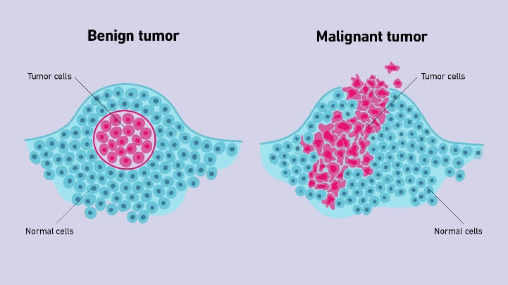
Types of Tumors

Slide 5

Why early detection of Breast Cancer is important?
Higher Survival Rates
Treatment Options
Prevention of Spread
Better Prognosis
Cost-Effective

Slide 6

Why we need a machine learning based solution?
Improved Accuracy
Faster Analysis
Early Detection
Personalized Care
Scalability
Consistency
Continuous Learning

Slide 7
Why we need a machine learning based solution?
Improved Accuracy: Detects patterns in medical data, reducing false positives and negatives.
Faster Analysis: Handles large, complex datasets efficiently for quicker results.
Early Detection: Identifies subtle signs, enabling timely treatment.
Personalized Care: Tailors recommendations based on patient-specific data.
Scalability: Deployable in diverse healthcare settings, including remote areas.
Consistency: Provides unbiased, fatigue-free analysis compared to manual methods.
Continuous Learning: Improves with new data, staying updated with advancements.
Machine learning enhances diagnostic precision, saves time, and improves patient outcomes.

Slide 8
Ensemble techniques & its types
Types:
-> Bagging: A technique where multiple independent models are trained on random subsets of data with replacement, reducing variance and avoiding overfitting.
-> Boosting: Models are trained sequentially, where each new model attempts to correct errors made by previous ones, focusing more on misclassified data.
-> Stacking: Combines the predictions of multiple models (base learners) using a meta-model to achieve better generalization.

Slide 9
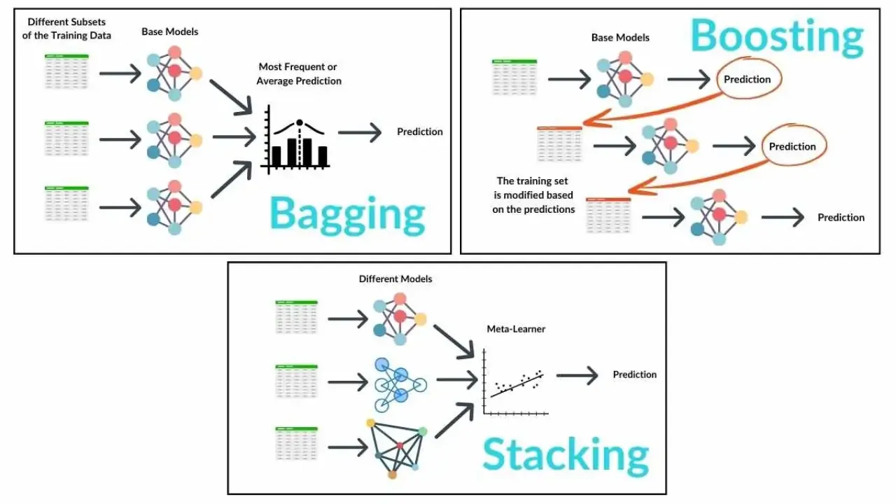

Slide 10

Why AdaBoost? A Smart Choice for Breast Cancer Diagnosis
AdaBoost is a “Boosting” ensemble technique that combines weak classifiers to form a strong classifier.
It builds models by adjusting the weight of each data point so that more focus is given to the samples misclassified by previous models.
-> Focus on Misclassified Samples
-> High Accuracy and Interpretability
-> Efficiency with Less Overfitting

Slide 11

Data Collection
The experimental results have been demonstrated with the help of the dataset “ UCI Breast Cancer Wisconsin Diagnostic Dataset ”
Link: https://archive.ics.uci.edu/dataset/17/breast+cancer+wisconsin+diagnostic

Slide 12


Step
Import required packages
numpy
pandas
seaborn
matplotlib
sklearn

Slide 13
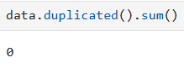
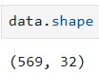

Data Preprocessing
identifying duplicate rows in a DataFrame
dimensionality of the DataFrame, which includes number of rows and columns
O/P indicates no duplicate values

Slide 14
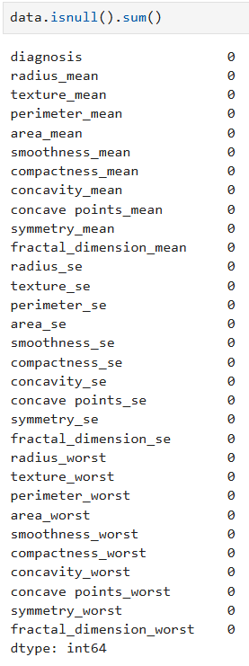
isnull - is to identify the missing values in the data frame
sum - is to get sum of all missing values per column
There is no missing values in the DataFrame

Slide 15
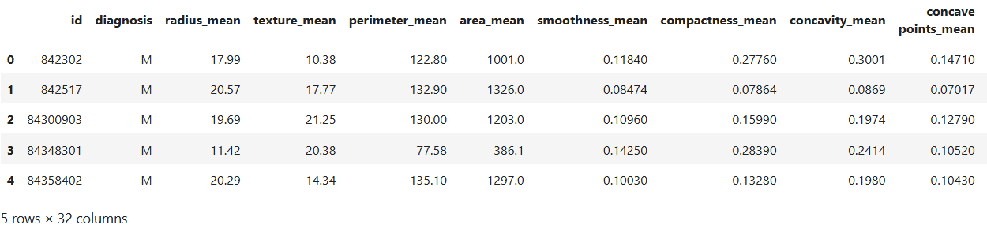

return the first n rows of a DataFrame
This is particularly useful for quickly checking the contents and data types of your DataFrame to ensure it has been loaded correctly
data.head()

Slide 16
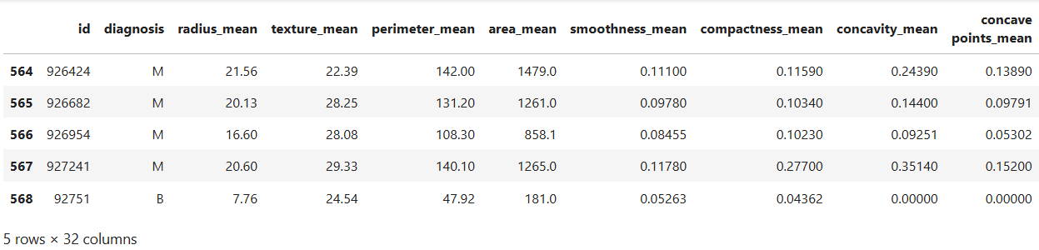
function is used to get the last n rows
It is useful for quickly verifying data, for example, after sorting or appending rows
data.tail()

Slide 17
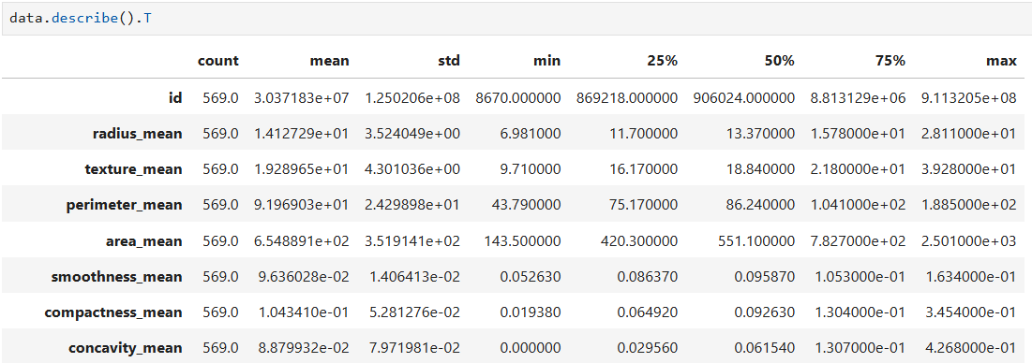
descriptive statistics of a DataFrame

Slide 18
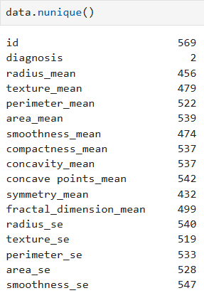
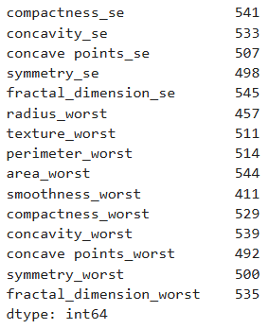
counting the number of distinct elements in a DataFrame
Diagnosis
B & M

Slide 19
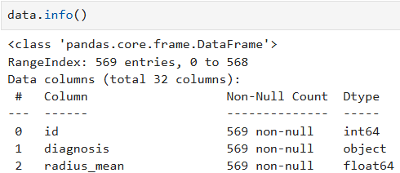
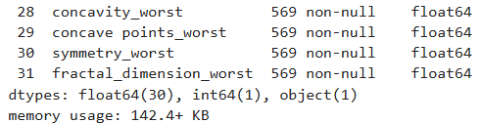
a concise summary of a DataFrame structure and information.

Slide 20
Every features other than diagnosis are integer and float
Diagnosis is the only categorical feature

Slide 21

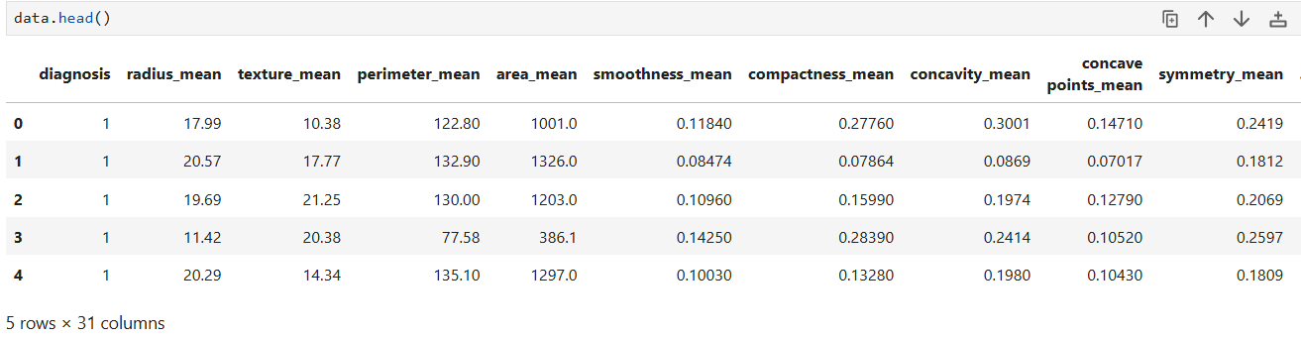
Encoding values
B as 0 &
M as 1

Slide 22

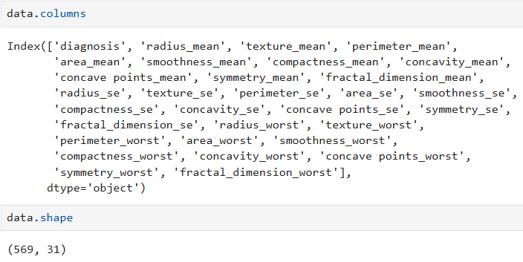
Dropping ID column as it doesn't carry any meaningful information
Checking whether ID column is dropped
Number of columns has reduced to 31

Slide 23
Exploratory Data Analysis (EDA)
Exploratory Data Analysis (EDA) is the process of analyzing and visualizing a dataset to summarize its main characteristics, often using statistical and graphical techniques.
The goal of EDA is to uncover patterns, identify anomalies, test hypotheses, and check assumptions before applying machine learning models.
It helps to better understand the data, clean it, and prepare it for further analysis or modeling.
Common EDA tasks include examining distributions, relationships between variables, missing values, and outliers using tools like histograms, scatter plots, box plots, and correlation matrices.

Slide 24
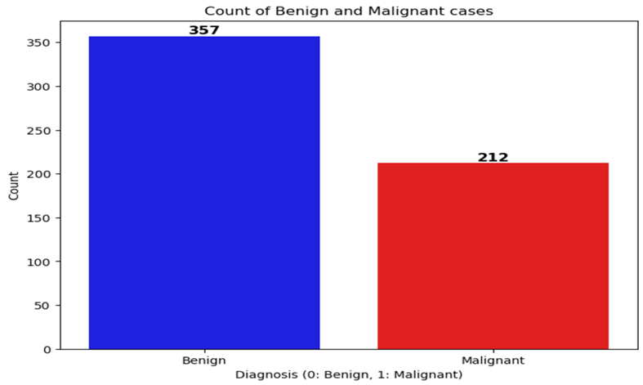
Data visualization

Slide 25
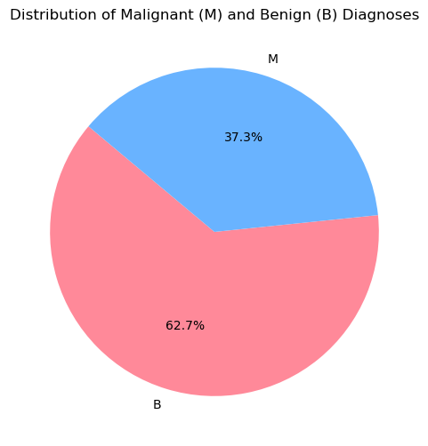
There is a Data Imbalance, therefore SMOTE is needed
Malignant (1)
Synthetic Minority Over-sampling Technique
is a method used to handle imbalanced datasets.
Benign (0)

Slide 26
Why SMOTE is Applied?
Imbalanced Dataset: Breast cancer datasets often have more benign (negative) cases than malignant (positive) cases, leading to poor model performance for detecting malignant cases.
SMOTE (Synthetic Minority Over-sampling Technique):
Generates synthetic samples for the minority class (malignant), balancing the dataset.
Impact: Improves model's ability to correctly identify malignant tumors.
Benefit: Higher recall and better overall classification performance for rare classes (malignant).

Slide 27
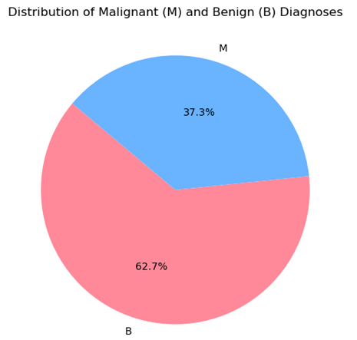
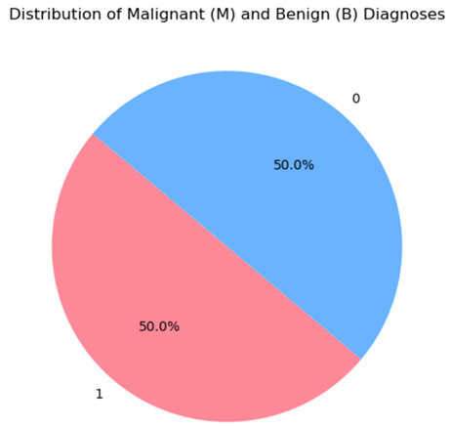
Before Smote
After Smote

Slide 28
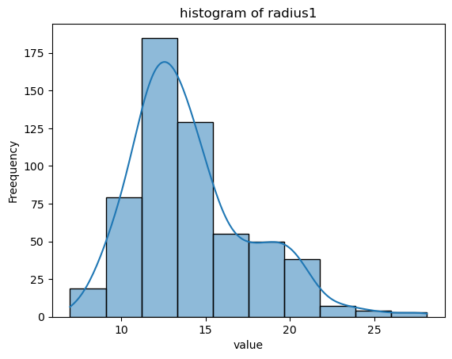
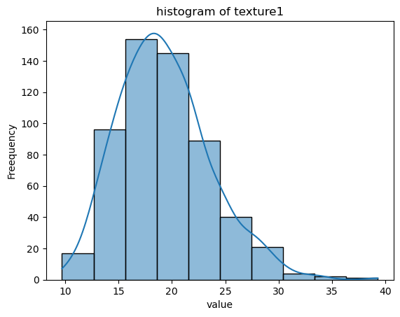
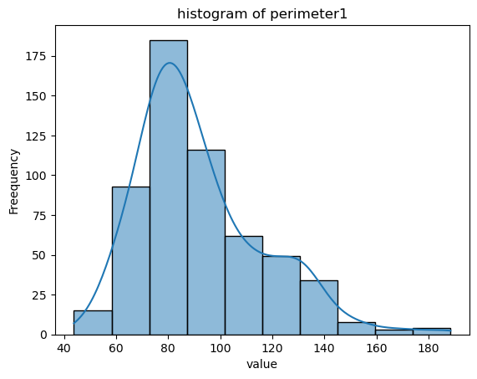
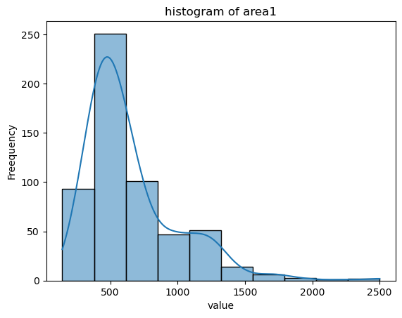
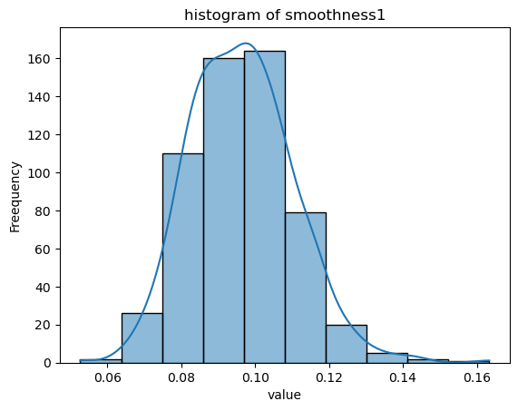

Slide 29
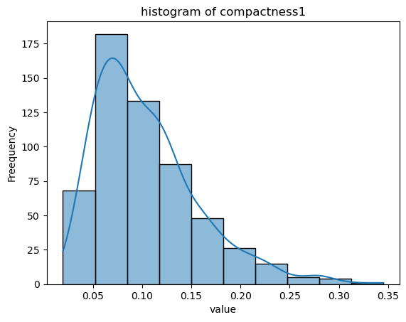
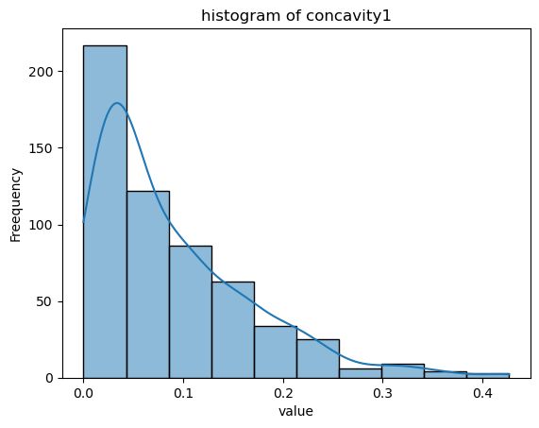
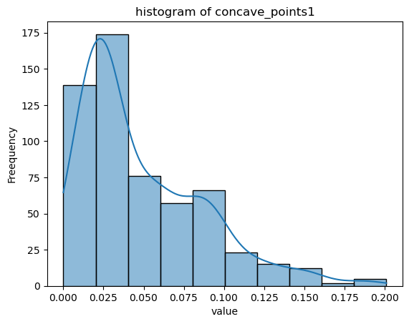
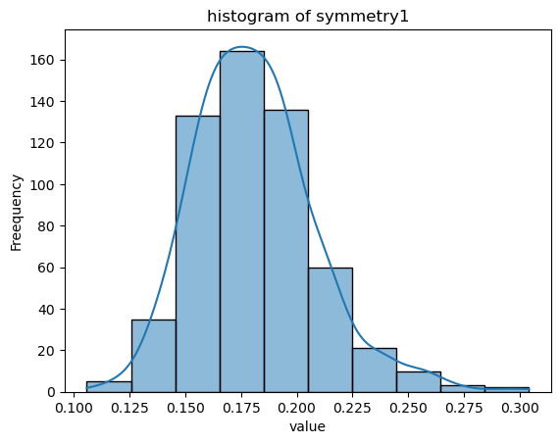
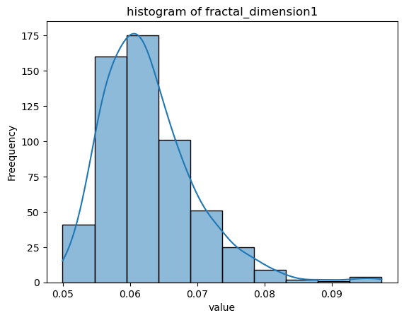
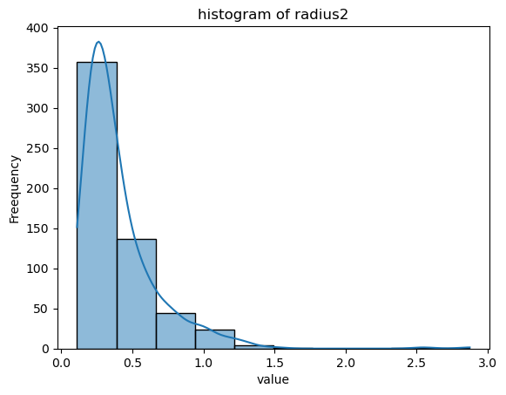

Slide 30
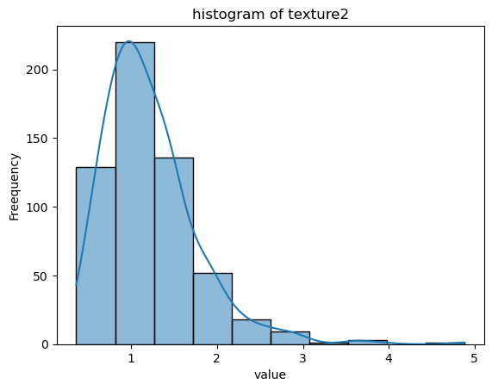
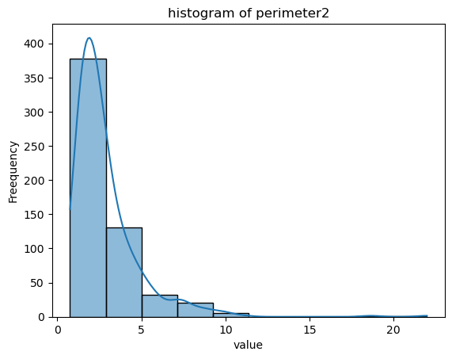
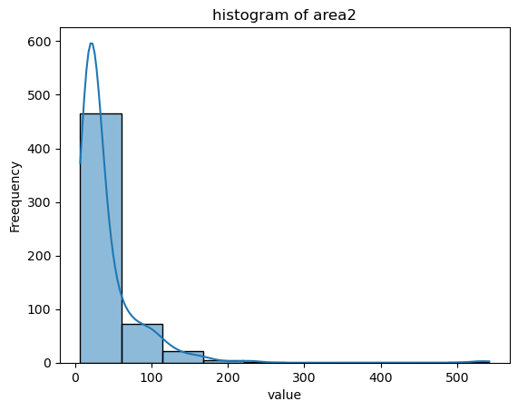
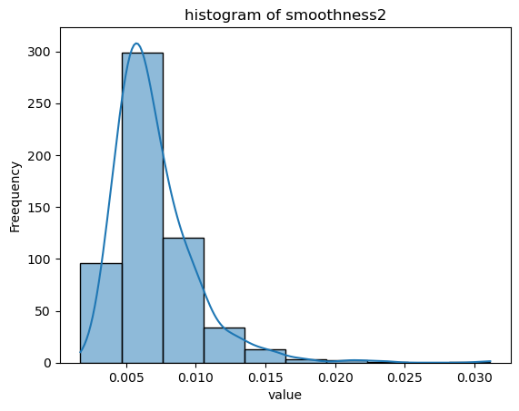
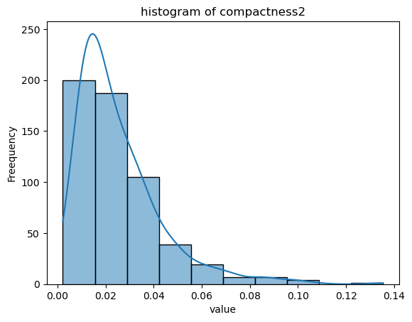
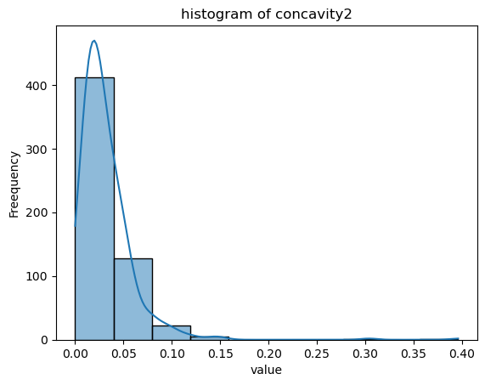

Slide 31
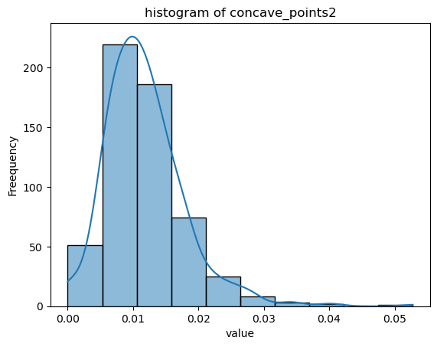
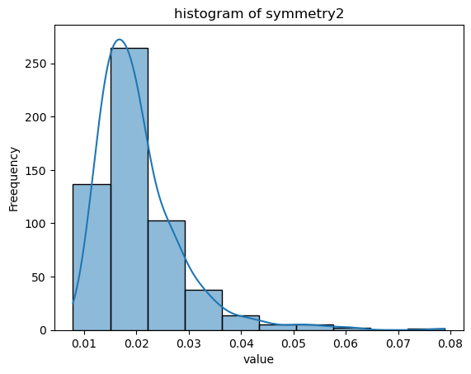
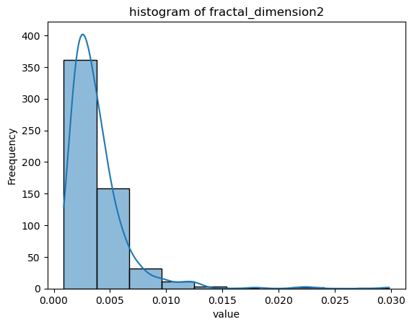
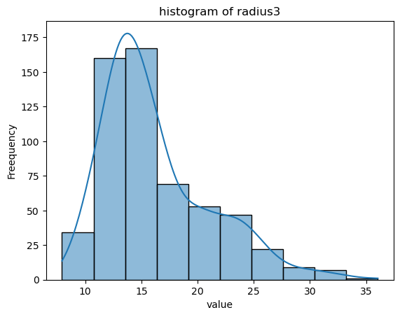
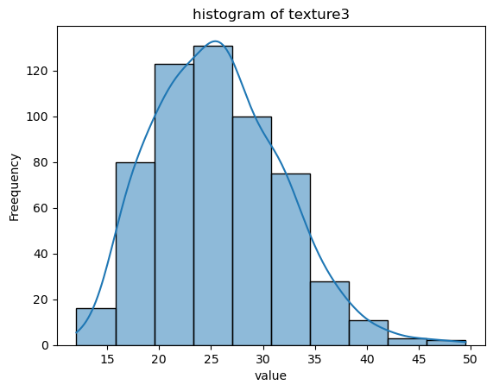
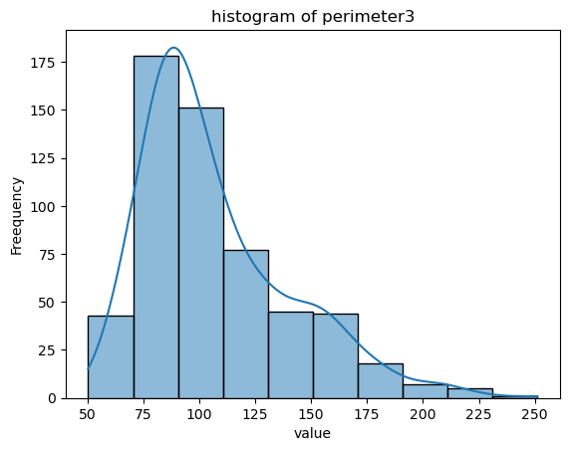

Slide 32
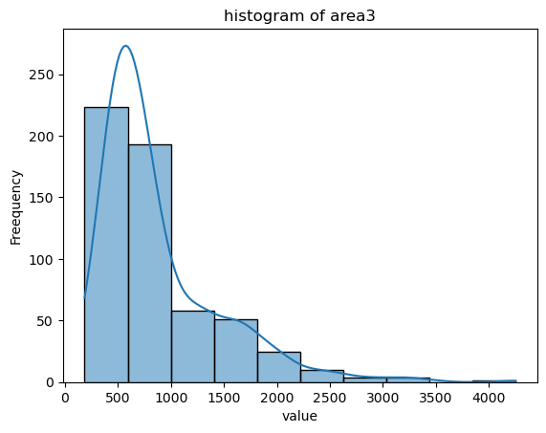
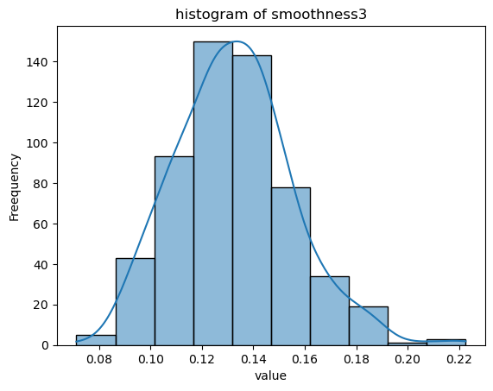
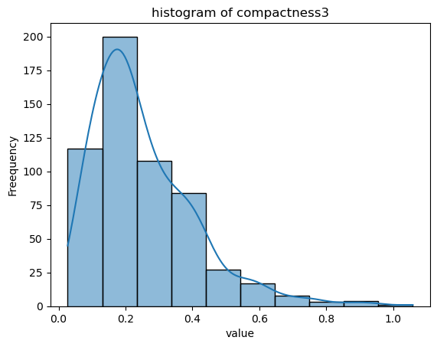
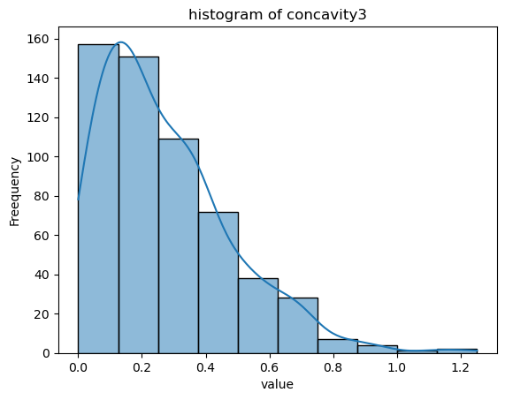
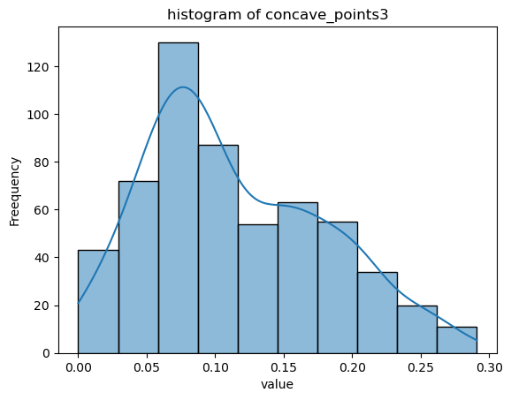
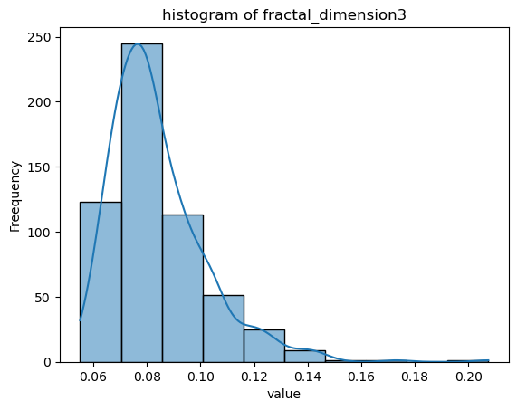

Slide 33
From the distribution graph we can infer that the distribution is either, right skewed or near normal
Therefore Standard Scaling can be applied

Slide 34
Training the Model
Model Selection:
We use multiple machine learning models to compare their performance on breast cancer detection:
AdaBoost
Logistic Regression (LR)
Decision Tree
Random Forest
XGBoost
Data Versions:
Raw Data: Model trained on the original, unprocessed dataset.
With SMOTE: SMOTE applied to generate synthetic data for the minority class.
Procedure: Split the dataset into training and testing sets (70% train, 30% test) for evaluation.

Slide 35
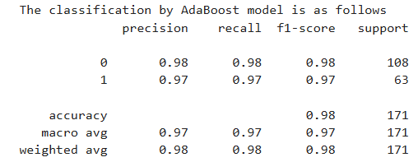
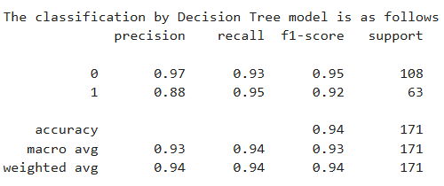
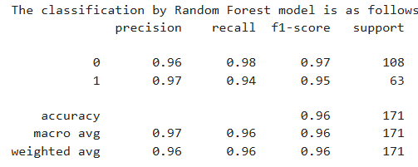

Without SMOTE

Slide 36




With SMOTE

Slide 37

Performance Analysis using AdaBoost Model with SMOTE

Slide 38
Comparing AdaBoost with Other Models
Overview of Results:
Each model was trained and evaluated on both raw and SMOTE-applied datasets.
AdaBoost showed superior performance compared to other models, particularly with SMOTE-applied data.
Metrics Analyzed:
Classification Report: Precision, recall, and F1-score for each model.
ROC Curve & AUC: Used to assess performance; AdaBoost with SMOTE yielded the highest AUC.
Conclusion: AdaBoost with SMOTE performed best, showing strong classification metrics and a high AUC.

Slide 39
Hyperparameter Tuning
Why Hyperparameter Tuning?
Improves model performance by finding the optimal set of hyperparameters.
GridSearchCV used for tuning AdaBoost, selecting the best parameters for better accuracy.
AdaBoost Hyperparameter Tuning:
Parameters like learning rate, number of estimators, and max depth were tuned.
Benefit of Hyperparameter Tuning:
Fine-tuning significantly enhanced the model’s ability to correctly classify malignant cases, reducing false negatives.

Slide 40


Performance Analysis using AdaBoost Model after hyperparameter tuning without SMOTE
Outcome: Improved accuracy to 98%, with excellent precision and recall.

Slide 41


Performance Analysis using AdaBoost Model after hyperparameter tuning with SMOTE
Outcome: Improved accuracy to 99%, with excellent precision and recall.
Final Model Choice:
AdaBoost with SMOTE is chosen as the final model due to its excellent performance on both balanced and imbalanced datasets, aided by hyperparameter tuning.

Slide 42

A Cut off of .03 is used for Variable selection
Data with Smote

Slide 43

A Cut off of .03 is used for Variable selection
Data without Smote

Slide 44


The models are recreated using the importance features and the hyper parameter tuning is also done
The Selected Models is loaded into Pickle Files, which will be accessed by the Streamlit App Later

Slide 45
Streamlit Application
-AI BREAST CANCER DIAGNOSTIC ASSISTANT
The AI Breast Cancer Diagnostic Assistant is a powerful tool designed to aid in the diagnosis of breast cancer using patient input features.
Utilizing the AdaBoost algorithm, the model achieves an impressive accuracy of 96.28% based on 215 samples.
This tool enables healthcare professionals to make accurate and timely diagnostic decisions, significantly enhancing clinical efficiency and patient care.

Slide 46

Streamlit Application
-AI BREAST CANCER DIAGNOSTIC ASSISTANT

Slide 47
Streamlit Application
A diagnostic prediction dashboard that evaluates various input features provided by the user, such as texture, concave points, area, and smoothness.
Based on the analysis, the prediction outcome is shown as Benign with a 67.9% confidence level, categorized under "Moderate Confidence Prediction."
A probability distribution chart illustrates the confidence split, with 67.9% indicating benign and 32.1% malignant, and it suggests additional testing for confirmation.
The dashboard effectively visualizes data to support decision-making.

Slide 48

Streamlit Application

Slide 49

MODEL PERFORMANCE ANALYSIS

Slide 50

1. ROC CURVE

Slide 51

2. PRECISION-RECALL

Slide 52

3. CONFUSION MATRIX

Slide 53

4. CLASSIFICATION REPORT

Slide 54


Slide 55


Team Members
Joseph Boban
Naveen S
Gayathri R
Krishna Raja Sree B
Shaik Ayesha Parveen

Slide 56

Team - 1

